Slide 1

Master’s Thesis Project
Agricultural Chatbot: Improving Context-Specific Query Resolution
with LLMs, RASA, and RAG Systems
In Collaboration with Professor A Ginige and Team (Western Sydney University)
Work By:
MADHAV MISHRA
M-Tech AI
2022AIM1004
Guided By:
Dr. Neeraj Goel
Assistant Professor
Department of CSE, IIT Ropar

Slide 2




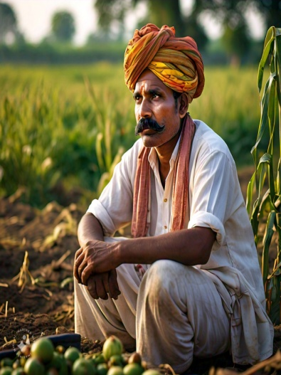

Introduction
Challenges
LLM
Lot of information: From many different resources
Trust issues :Traditional vs. academic knowledge Language problems: Difficulty in understanding due to language differences

Slide 3






Introduction
Solution - Chat-bot

Slide 4







OLD Architecture
Backend
Augmentation
Knowledge
Interface
UserInterface
Sanitiser
Knowledge-base
{}
Prompt Generator
Query Analyser
Analytics
LLM
Interface
Logs
Interface
LLM
Logs and Feedbacks
Kumar, M., Wilson, S., Goel, N., Ginige, A. (2025). KrishiAI: Architecture for Harnessing Capabilities of LLMs for Delivery of Accurate Cultivation Information to Farmers.
In: Saini, M.K., Goel, N., Miguez, M., Singh, D. (eds) Agricultural-Centric Computation. ICA 2024. Communications in Computer and Information Science, vol 2207.

Slide 5
Problems in the OLD Architecture
Does not ask for more information in case of incomplete information
Scope is limited to Knowledge Model
Scalability issues in Knowledge Model

Slide 6

Problems with Solution
Does not ask for more information in case of incomplete information
RASA
Ask Clarification
Action Trigger
yes
Query
Information missing ?
Intent Classification

Slide 7
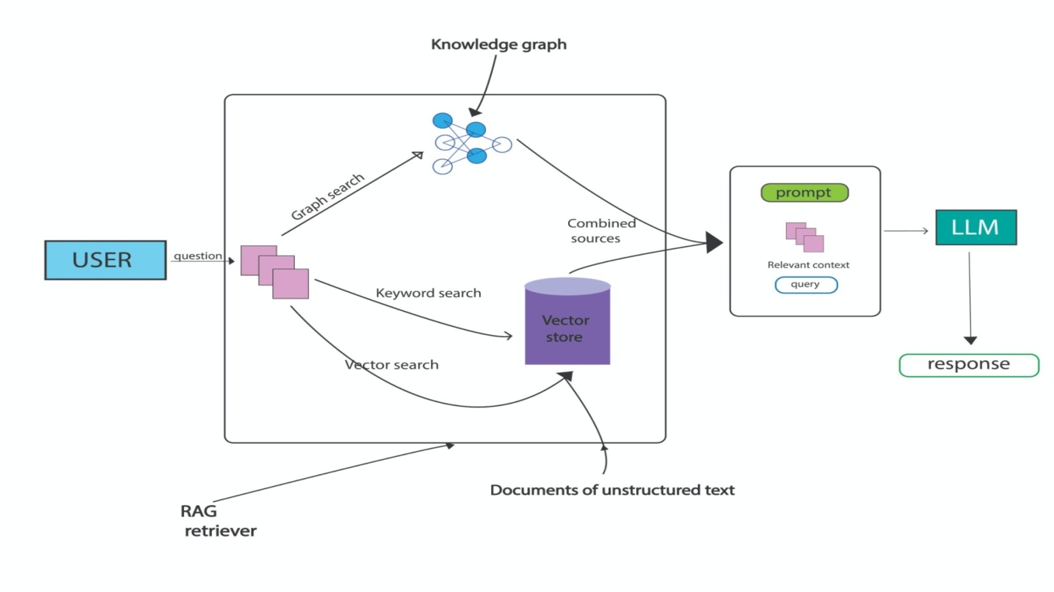
Problems with Solution
Scope is limited to Knowledge Model - RAG
Scalability issues in Knowledge Model - RAG

Slide 8
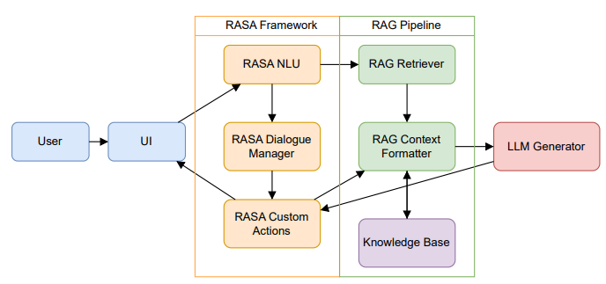
Proposed Architecture

Slide 9
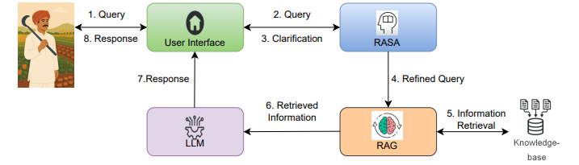
Basic Idea

Slide 10
Development of RASA Module
Requirements :
Dataset for intent and entity training – KCC & KVK
Slot Identification - Expert
Updating RASA for collecting missing information – S/W Development

Slide 11
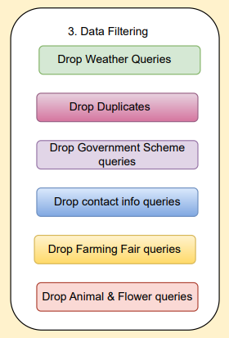
Data Collection & RASA Training
1.KCC data of Punjab and Uttar Pradesh (40K Queries)
2. Data Filtering and considered two features Query type and Query Text
3. Consult with agriculture experts and decided Slots for Query Type
4. Total 35 types of query Intents with 1360 queries used to train RASA
RASA NLU module

Slide 12
Key Challenges
Users often ask ambiguous questions, and the bot might struggle to extract correct intent of the query.
Rasa requires good-quality training data for intents, entities.
Decide the slots for intents.
Solution:
Using slots, clarification questions are asked by RASA.
Took reference from KCC dataset and dataset used in Intelligent Chatbot Assistant in Agriculture Domain[3] .
Referring agriculture related handbooks and Agriculture expert’s advice.

Slide 13
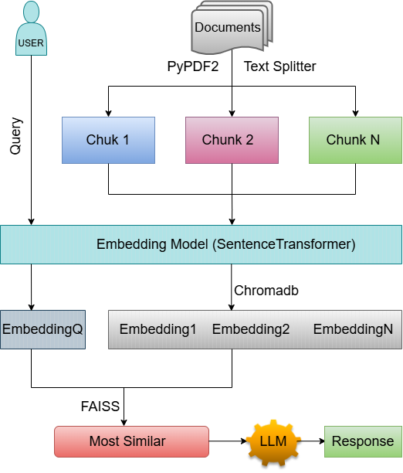
RAG Implementation

Slide 14
RAG Implementation
Documents Used :
Rice Cultivation Handbook by National Agriculture Research Organization
Farmer’s Handbook on Basic Agriculture by Desai Fruits & Vegetables Pvt. Ltd.
Handbook of Agriculture by Indian Council of Agriculture Research

Slide 15
RAG Implementation
Components :
Enbedding Model : sentence-transformers
Vector Store : chromadb
Chunking : langchain.text_splitter
Retrieval : FAISS
LLM : gpt-3.5 turbo

Slide 16
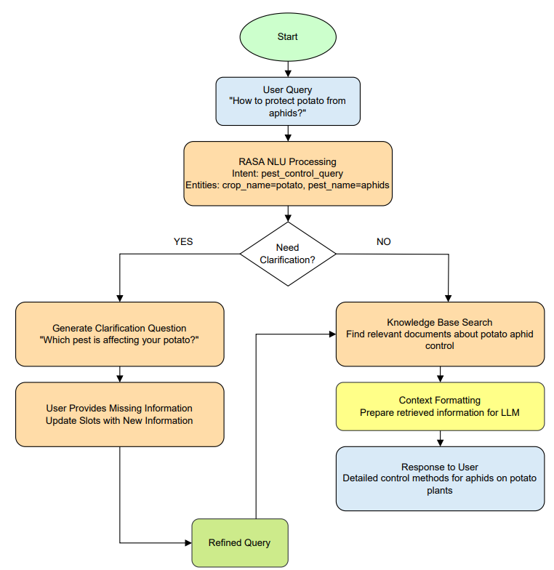
Complete Flow of the System

Slide 17
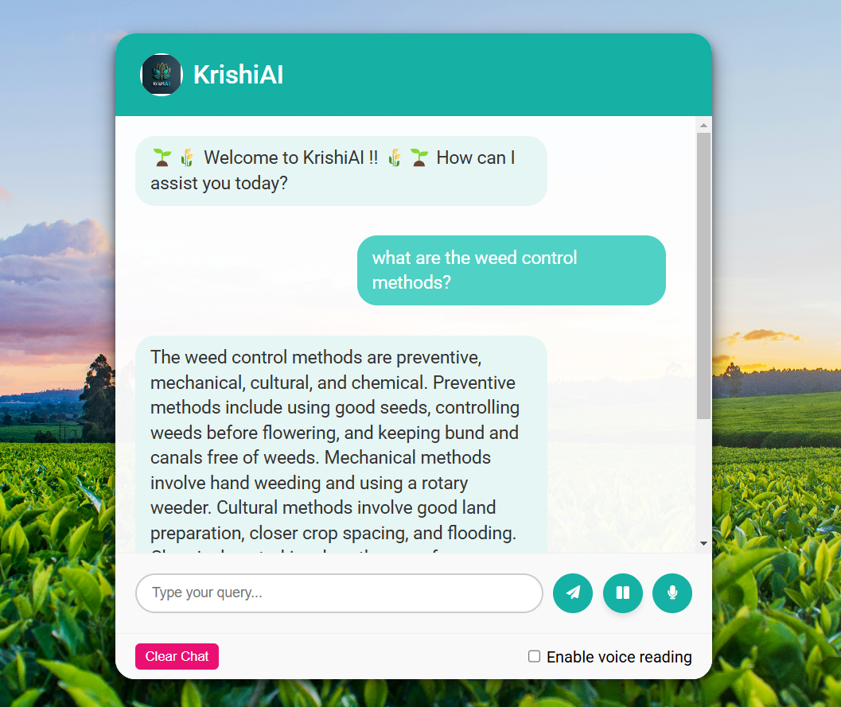
ChatBot Interface
Functionalities-
Text and Voice modes
Pause button
Voice reading mode
Clear chat at any time

Slide 18
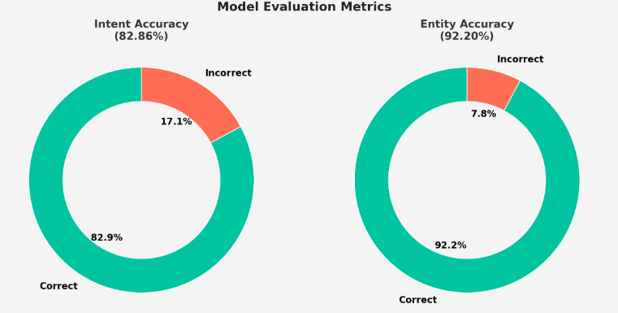
RASA Module Testing
1. NLU Model Performance Summary (35 Intents)
2. A test dataset consists of 140 queries from different types of intents

Slide 19
Testing of RAG
Manually identified 50 questions and their correct answers from the documents.
These answers serve as the ground truth for evaluation.
Question: Which upland rice variety has an aromatic grain, and what are its maturity period and yield?
Answer: NERICA 1 has an aromatic grain. Its maturity period is 105–115 days, and its yield is 3–4 tons per hectare.
RAG Response: The upland rice variety with an aromatic grain is NERICA 1. Its maturity period is 105-115 days, and the yield ranges from 3 to 4 tons per hectare.

Slide 20
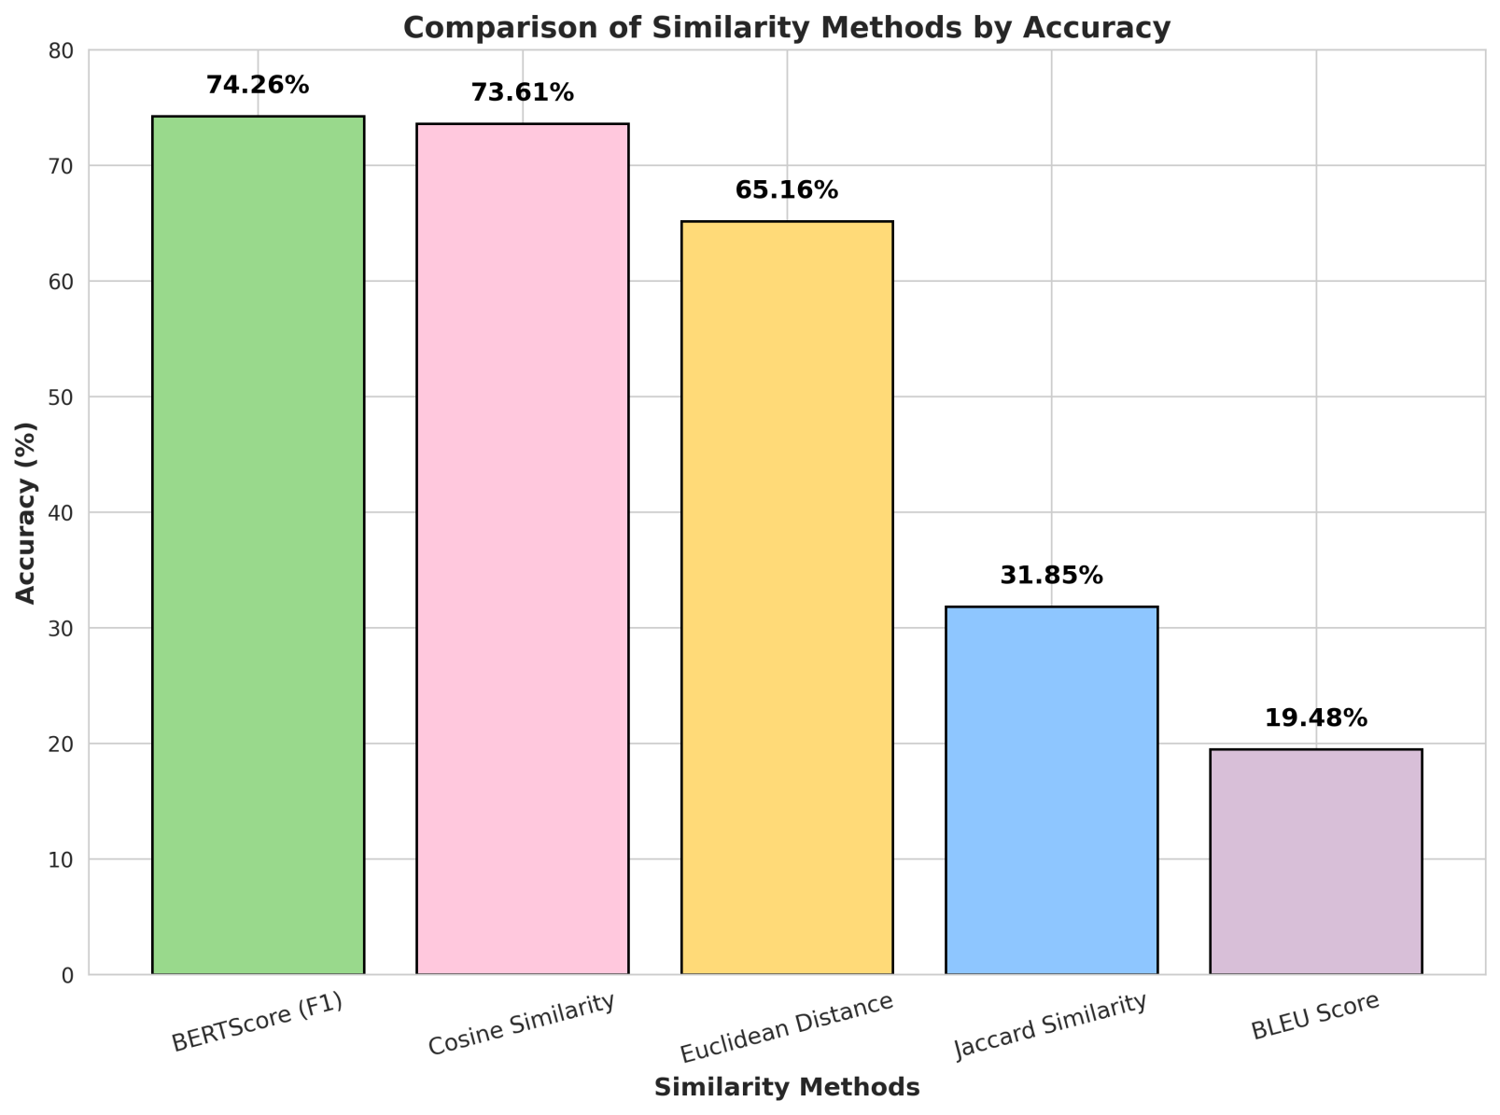
Accuracy of RAG

Slide 21
Comparison between RAG & GraphRAG
Method | Queries Answered (out of 21) | Accuracy
RAG ( Embedding-based) | 20 | 95.2 %
GraphRAG | 15 | 71.4 %
Observation:
Traditional RAG showed higher coverage and retrieval performance in this evaluation.

Slide 22
System Evaluation Methodology
Test Cases Designed
Abstract Queries (e.g., "How to protect my crop?")
Complete Queries (e.g., "How to protect potato from aphids?")
Total: 140 test cases (70 each type) covering diverse query intents.
Metric
Clarification Accuracy : 82.86%
Retrieval Accuracy : 97.56%
Response Accuracy & Completeness : 74.26%

Slide 23
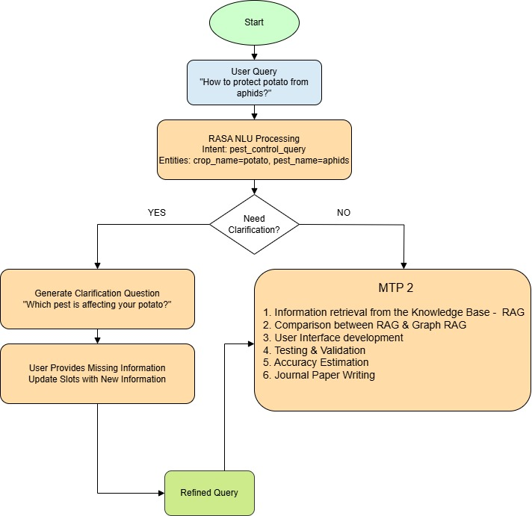
Work Done in MTP 1
Dataset Collection & Processing
Designed a RASA module to extract the intent & entity.
RASA is able to gather the missing information.
I had started developing the RAG module.

Slide 24
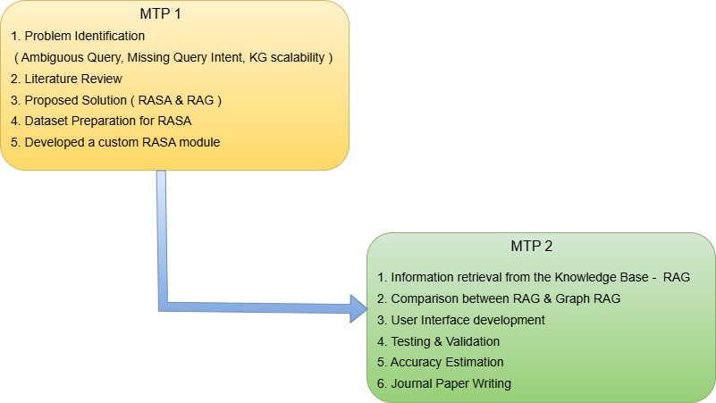
Work Done in MTP 1 & MTP 2

Slide 25
Timeline
Finalized the Pipeline
Developed Basic structure of RASA
September - October
Implementing the pipeline for initial stage processing
Testing the existing system
November-December
July - August
Prototype RAG implementation
Implementation and Integration
Supplementary dataset for RAG and RASA
ChatBot interface, Journal Paper Writing
March - April
Comparison between RAG and GraphRAG
May
Jan - Feb
Testing and Validation
Accuracy estimation

Slide 26

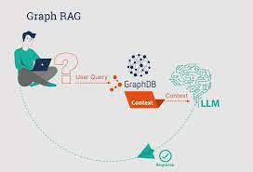
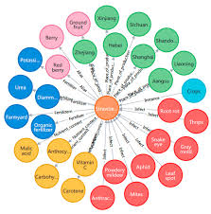
Support From Western Sydney University
Journal
Paper
2. GraphRAG
1. Knowledge Graph Development
3. Journal Paper Support
https://www.ontotext.com/knowledgehub/videos/graph-rag-with-graphdb-talk-to-your-graph/

Slide 27
References
M. Momaya, A. Khanna, J. Sadavarte and M. Sankhe, "Krushi – The Farmer Chatbot," 2021 International Conference on Communication information and Computing Technology (ICCICT), Mumbai, India, 2021, pp. 1-6, doi: 10.1109/ICCICT50803.2021.9510040.
(2) Fleischer, Daniel, et al. "RAG Foundry: A Framework for Enhancing LLMs for Retrieval Augmented Generation." arXiv preprint arXiv:2408.02545 (2024).
(3) Biswas, R., Goel, N. (2023). Intelligent Chatbot Assistant in Agriculture Domain. In: Saini, M.K., Goel, N., Shekhawat, H.S., Mauri, J.L., Singh, D. (eds) Agriculture-Centric Computation. ICA 2023. Communications in Computer and Information Science, vol 1866. Springer, Cham. https://doi.org/10.1007/978-3-031-43605-5_14

Slide 28
THANK YOU

Slide 29

Proposed Architecture
UI
RASA
LLM Interface
LLM
Knowledge Interface
Knowledge Base
Supplementary Data
RAG
Query Analyzer

Slide 30

Literature Review
Retrieval Augmented Generation (RAG)[2]
Fleischer, Daniel, et al. "RAG Foundry: A Framework for Enhancing LLMs for Retrieval Augmented Generation." arXiv preprint arXiv:2408.02545 (2024).

Slide 31
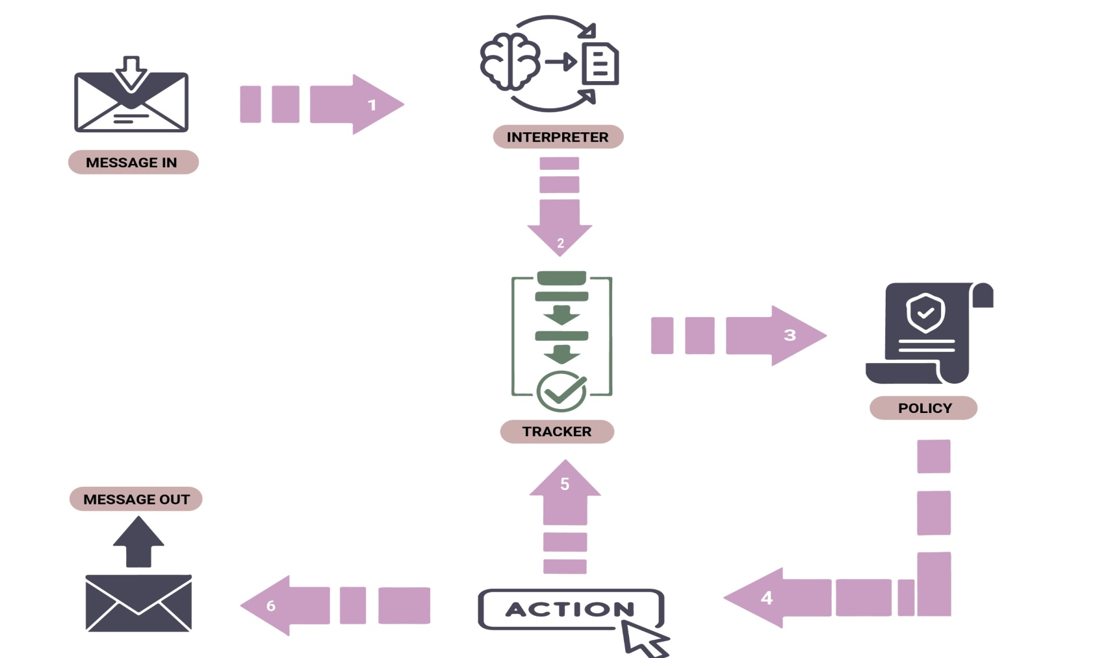
RASA Flow
RASA Framework [1]
M. Momaya, A. Khanna, J. Sadavarte and M. Sankhe, "Krushi – The Farmer Chatbot," 2021 International Conference on Communication information and Computing Technology (ICCICT), Mumbai, India, 2021, pp. 1-6, doi: 10.1109/ICCICT50803.2021.9510040.

Slide 32
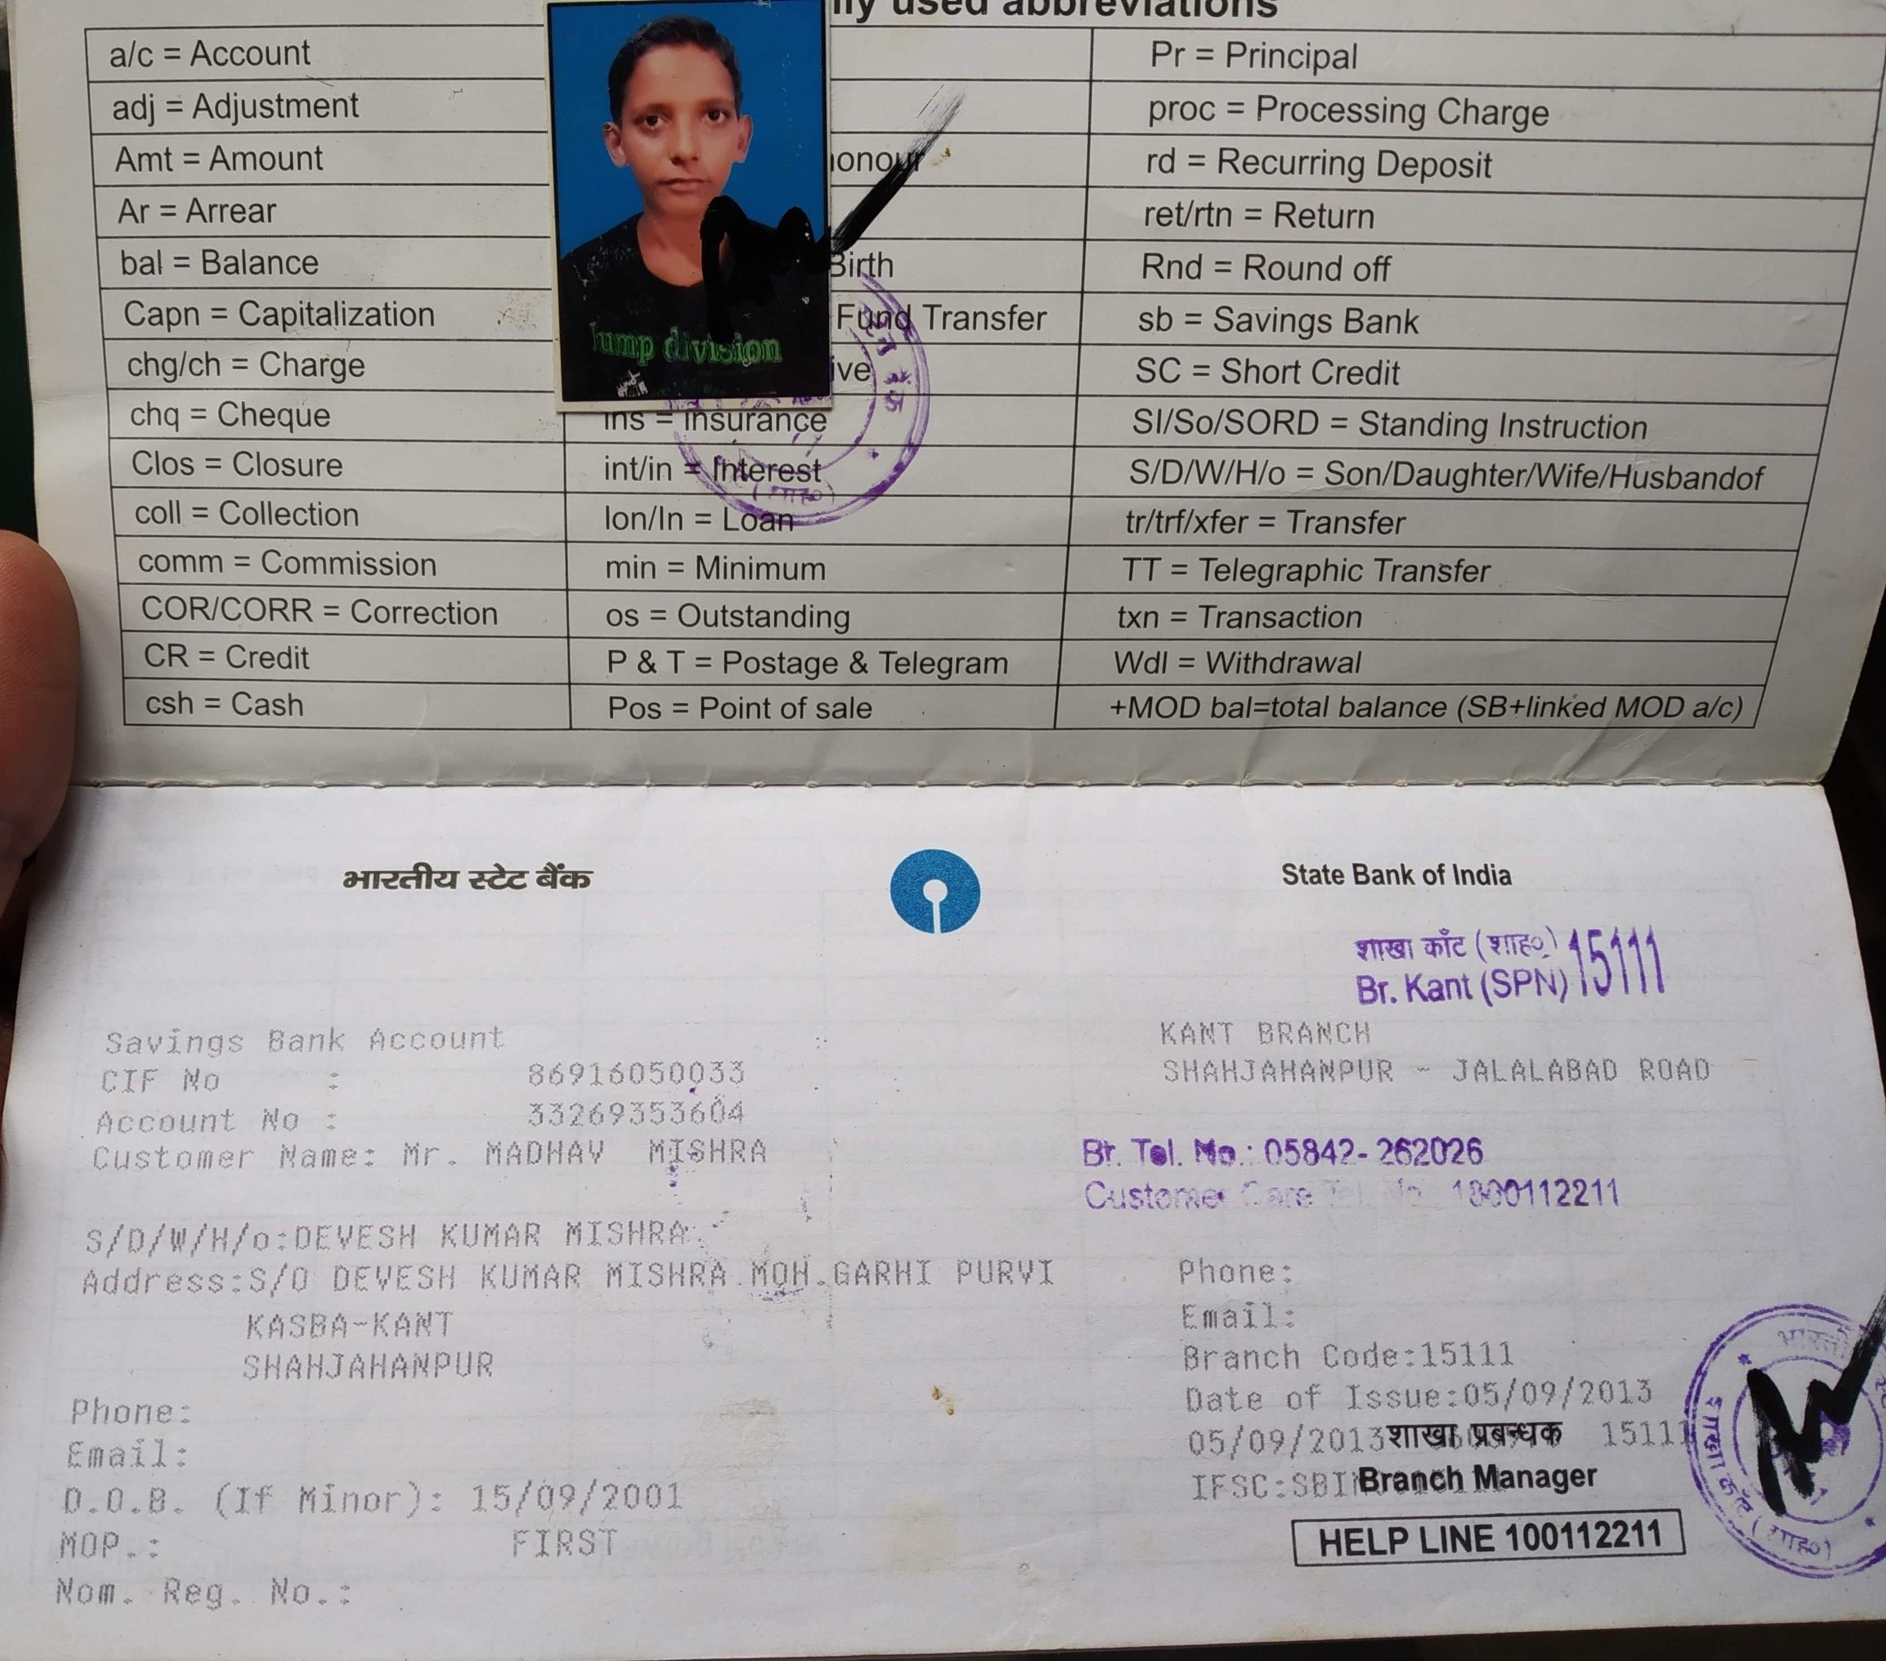
15/05/2001

